Slide 1
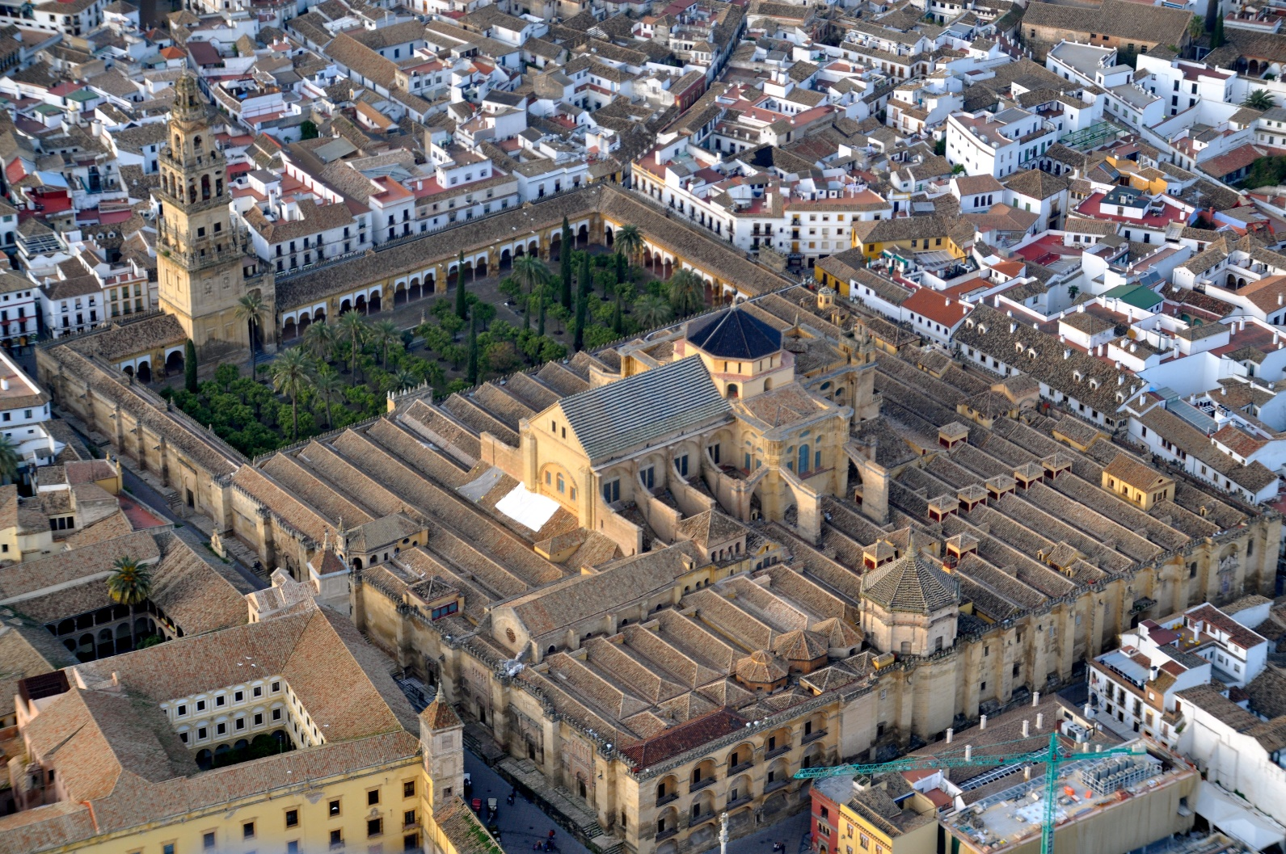
Mosque–Cathedral of Córdoba
Mezquita-Catedral de Córdoba

Slide 2
Mosque–Cathedral of Córdoba
(Spanish: Mezquita-Catedral de Córdoba) Roman Catholic Diocese cathedral of Córdoba, dedicated to the Assumption of Mary.
Being a former Islamic mosque, also known as the Great Mosque of Córdoba.

Slide 3
Mosque–Cathedral of Córdoba
First used to be a temple to the Roman god, Janus.
Converted into a church by invading Visigoths who seized Córdoba in 572.
Next, converted into The Great Mosque, then completely rebuilt on orders of Abd ar-Rahman I in 785.
Then converted into a cathedral in 1236, Córdoba was captured by the Christian forces of Castile during the Reconquista.

Slide 4
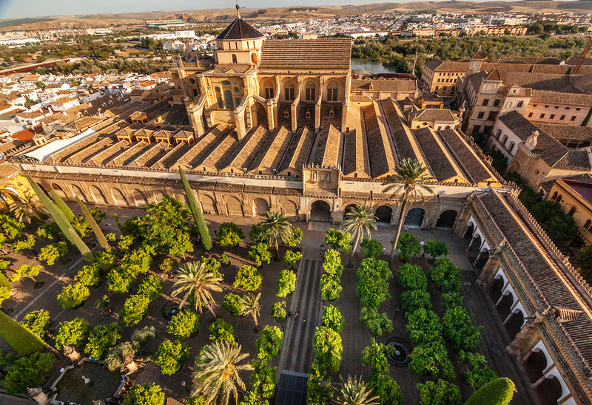
Mosque–Cathedral of Córdoba
The mosque structure, an important monument in the history of Islamic architecture

Slide 5
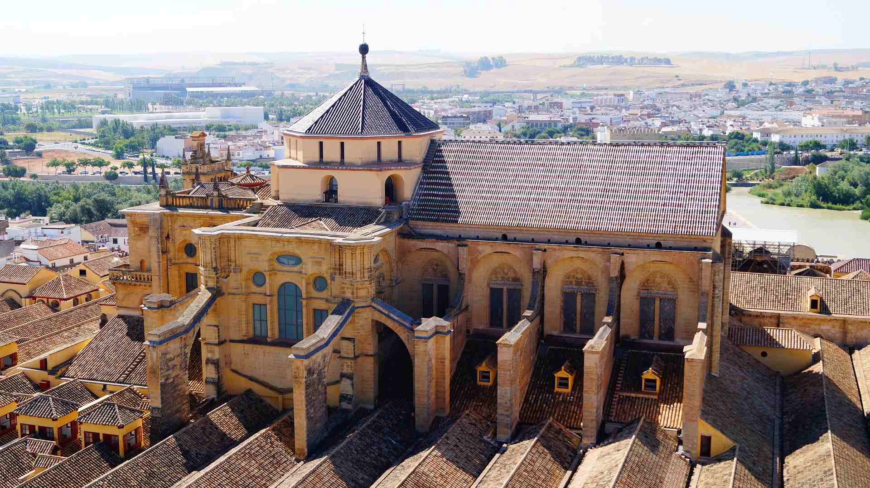
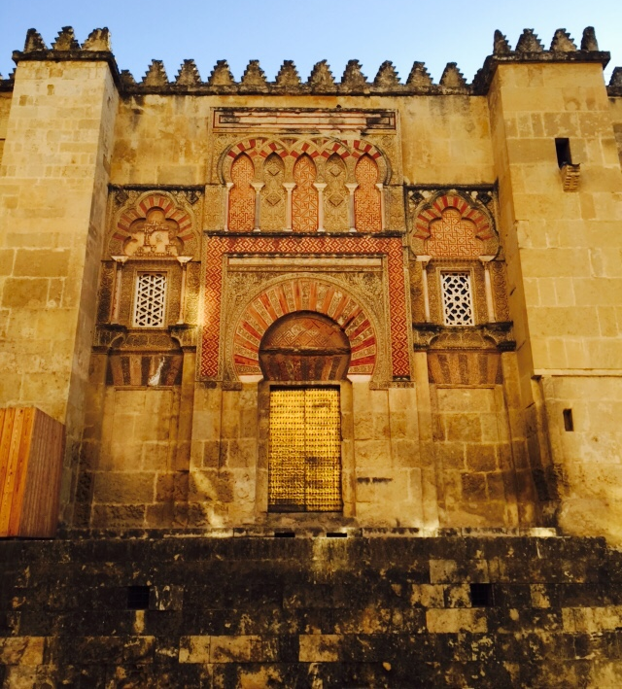
Mosque–Cathedral of Córdoba
Caliphal entrance on the west side

Slide 6
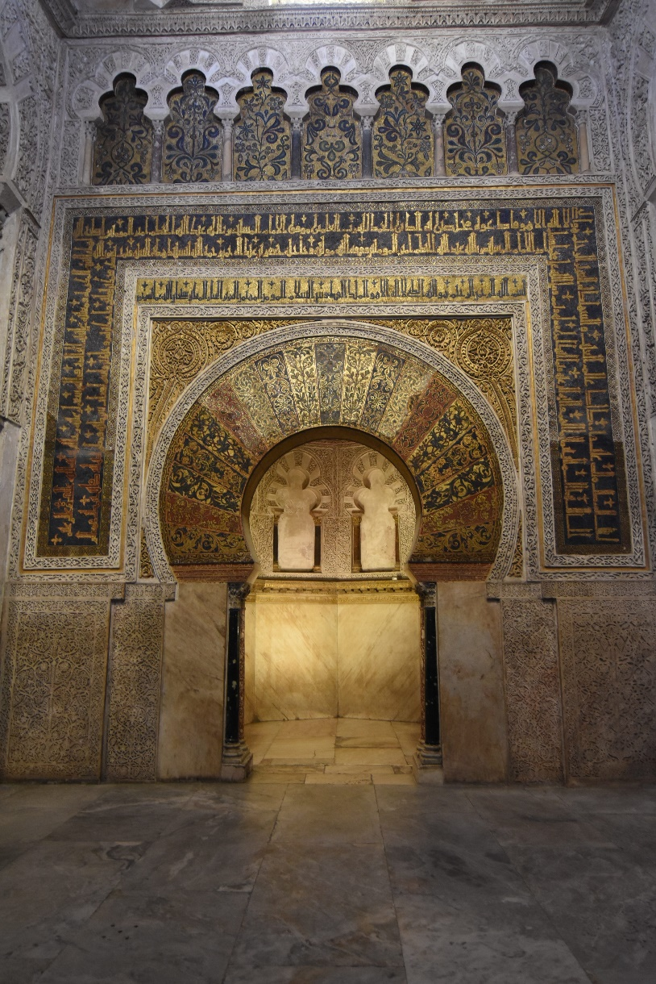
Mosque–Cathedral of Córdoba
The mihrab or prayer niche, framed by a horseshoe arch decorated with gold and color tesserae.

Slide 7
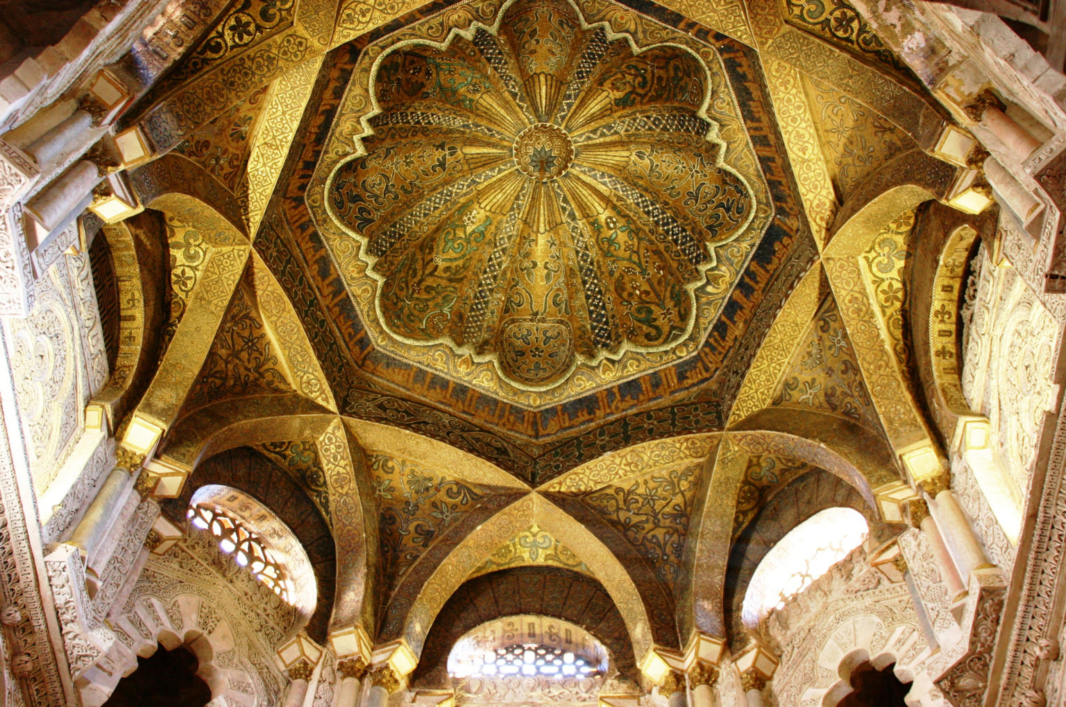
Mosque–Cathedral of Córdoba
Dome built above the mihrab

Slide 8
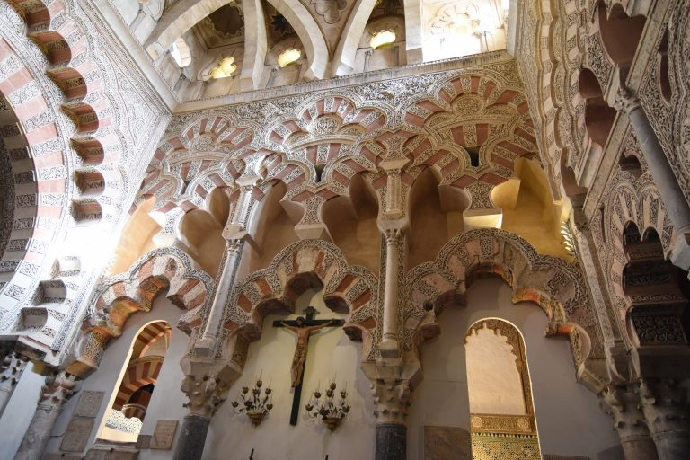
Mosque–Cathedral of Córdoba
Cathedral

Slide 9
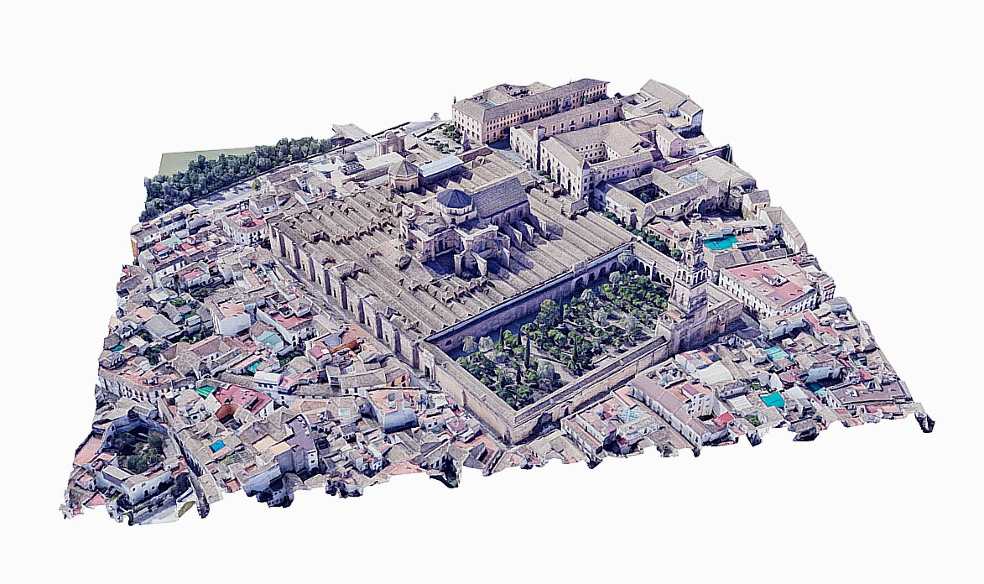
Mosque–Cathedral of Córdoba
3D models available for The Mosque–Cathedral of Córdoba:

Slide 10
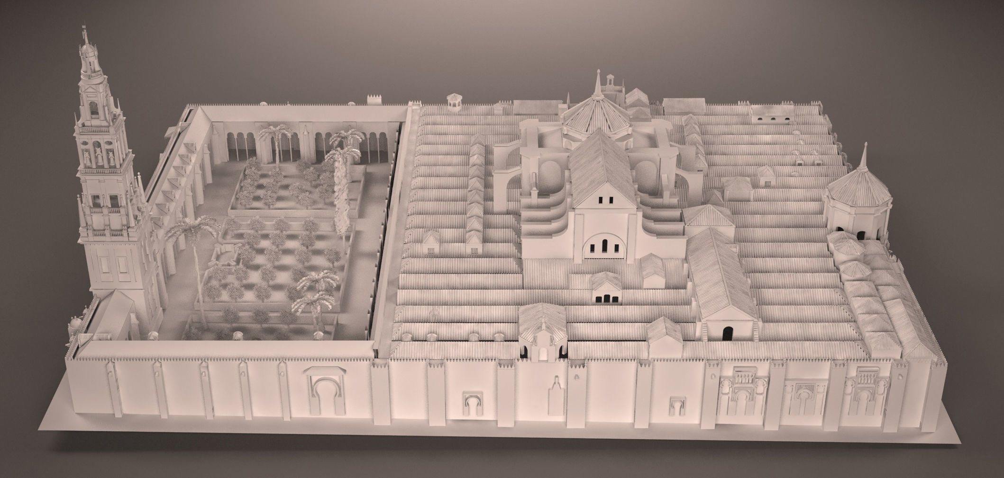
Mosque–Cathedral of Córdoba

Slide 11
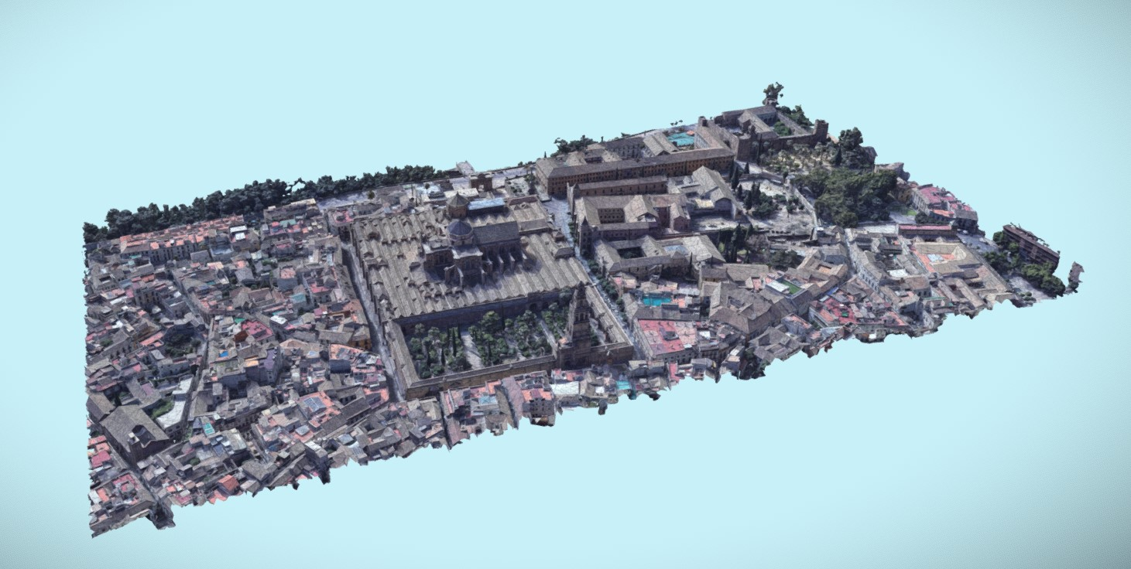
Mosque–Cathedral of Córdoba

Slide 12
Mosque–Cathedral of Córdoba
Most of the 3D models available are of the exterior of the architecture.

